Slide 1
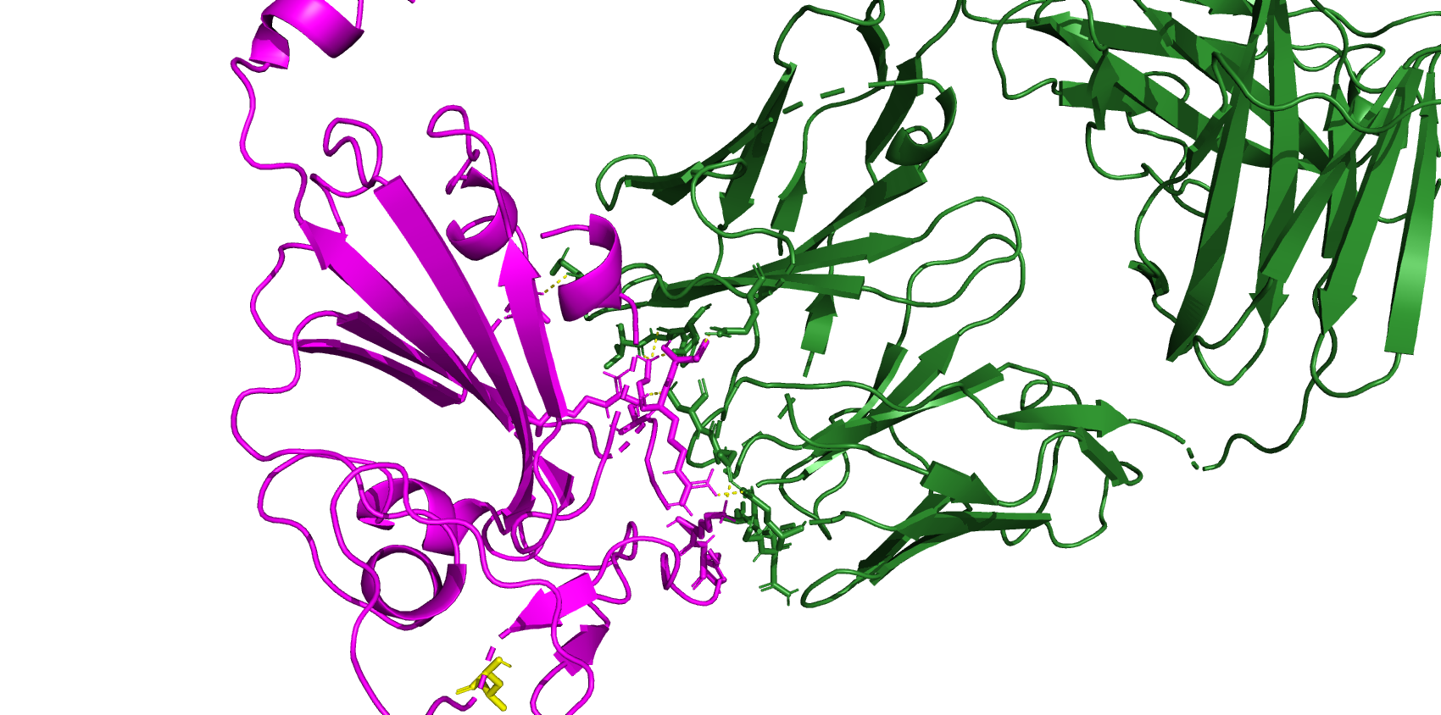
8dw9 BA286 (JN1 is after this)
A372
K440
T345
R508
K444
R346
L455

Slide 2
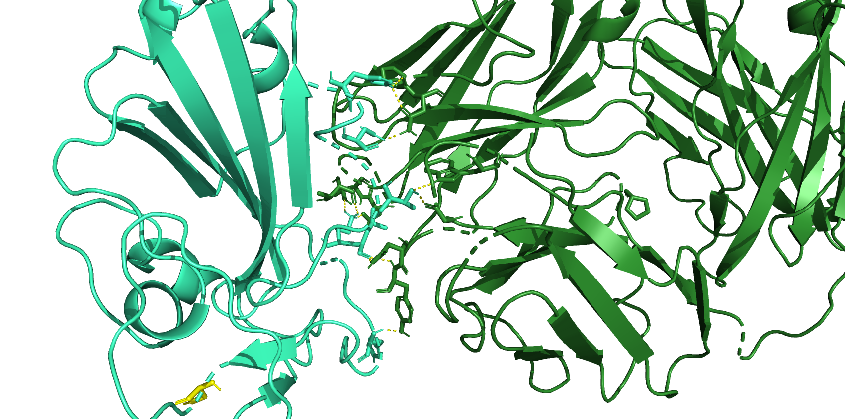
H339
N343
T345
K440
L441
H445
S455

Slide 3
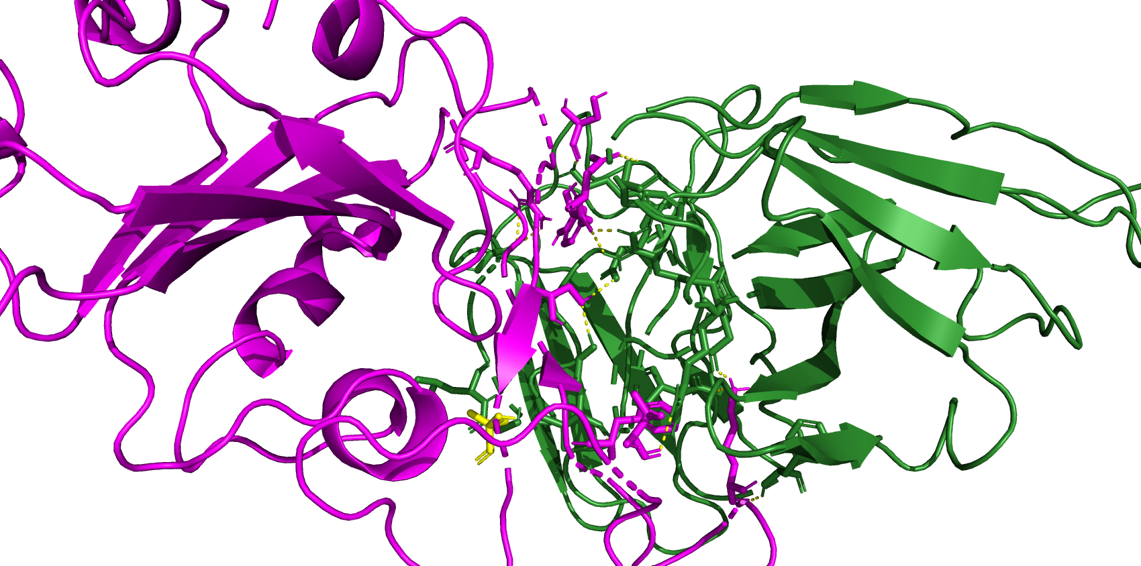
7xd2 BA.2.86 (jn.1 is after this)
R497
S446
D450
Y449
S493
I100
F489
K483
L455
T470

Slide 4
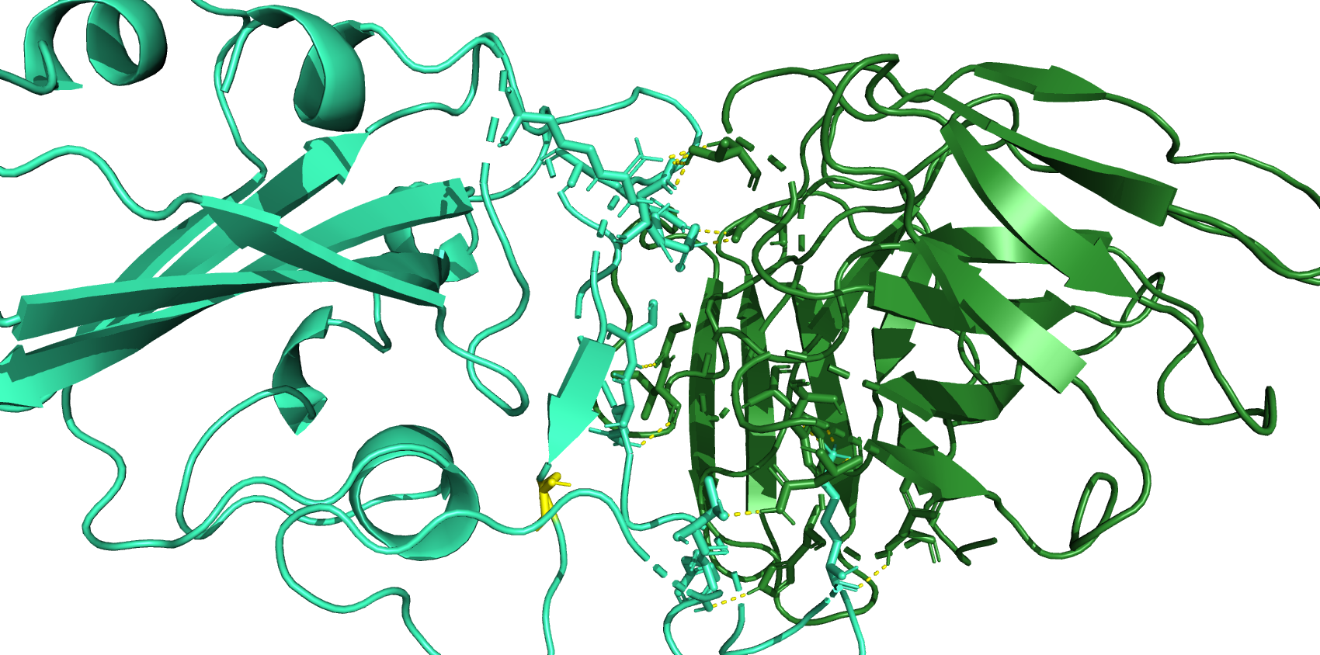
D450
R346
R497
Y449
S493
Q492
S455
K483
T470
Y488

Slide 5
H339
N343
A372
T345
K440
K440
T345
L441
R508
K444
R346
H445
S455
L455
(A)
(B)
D450
R497
S446
R346
R497
D450
Y449
Y449
S493
S493
I100
Q492
F489
S455
K483
K483
L455
T470
T470
(C)
(D)
Y488

Slide 6
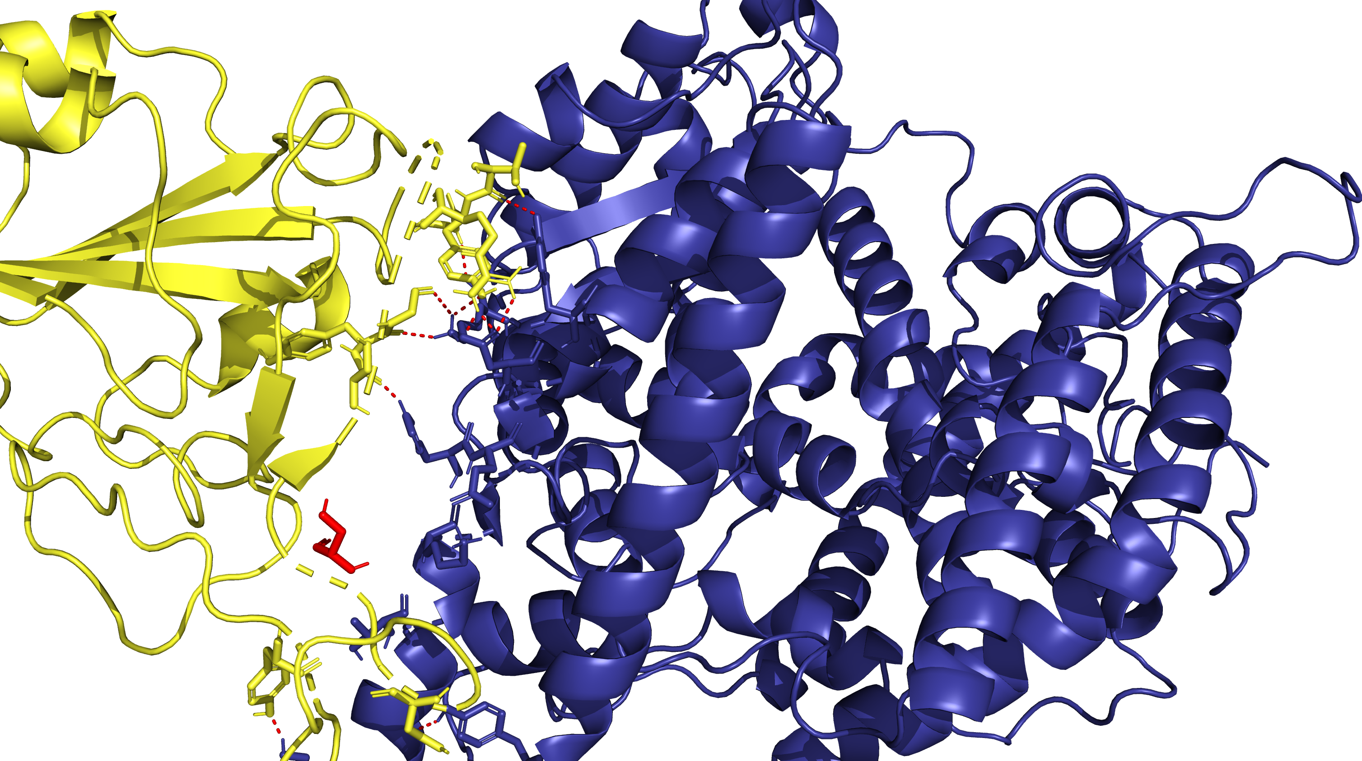
T500
G502
R498
G496
Y495
Y501
S494
H34
E35
S490
K31
T27
N487
Y473
(A)

Slide 7
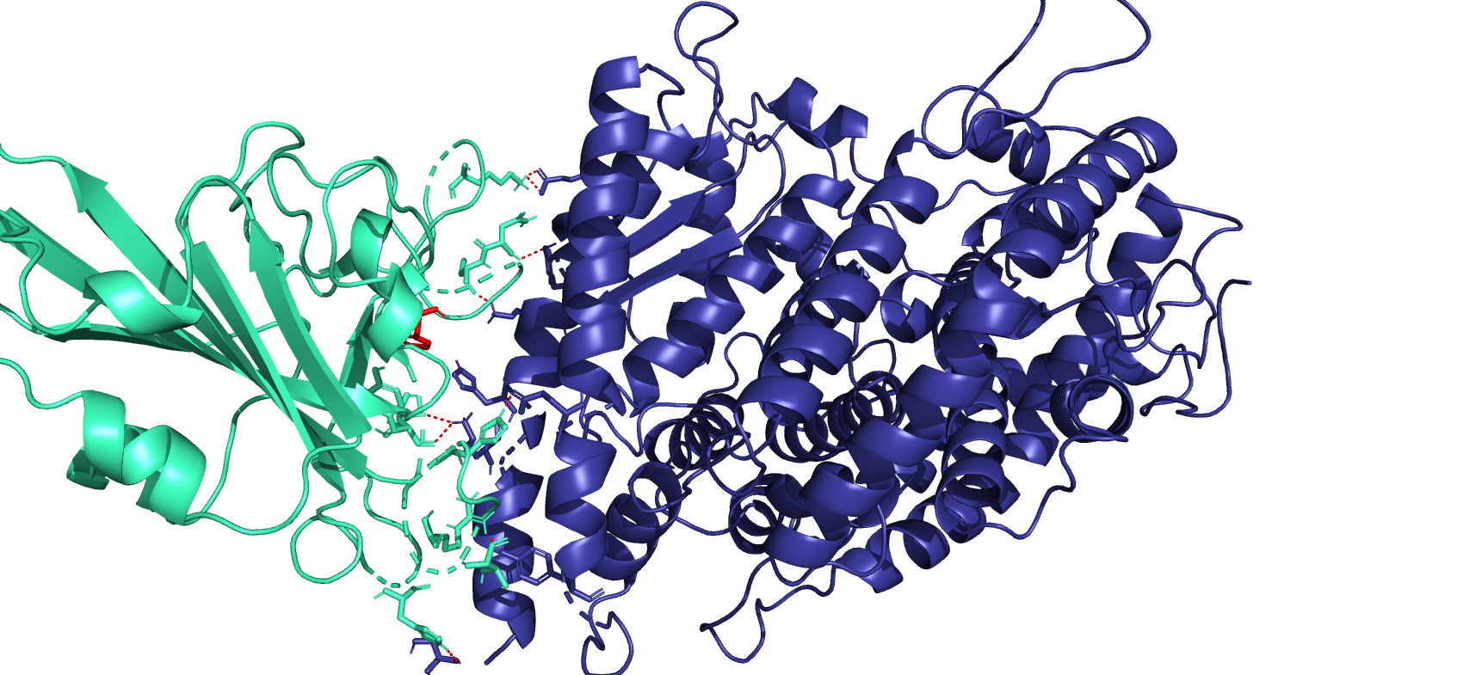
K478
N486
C487
H504
F489
H34
S493
Y494
H504
R497
T499
H445
(B)

Slide 8
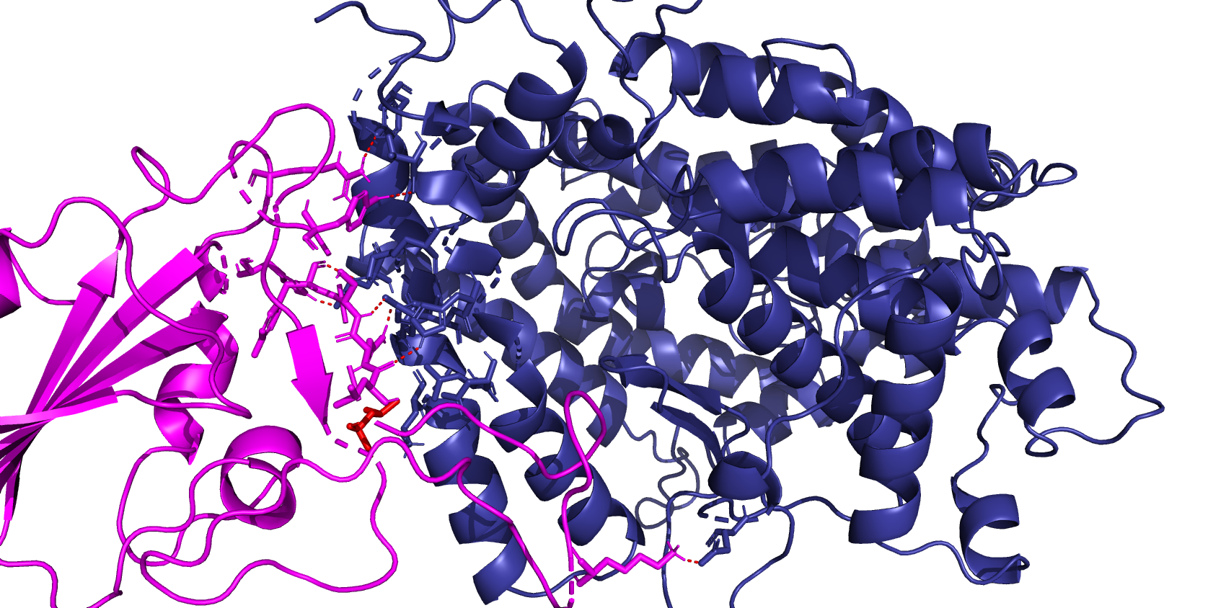
R497
Y449
H504
S493
Y494
F72
Q492
L491
L39
L455
K478
(C)

Slide 9
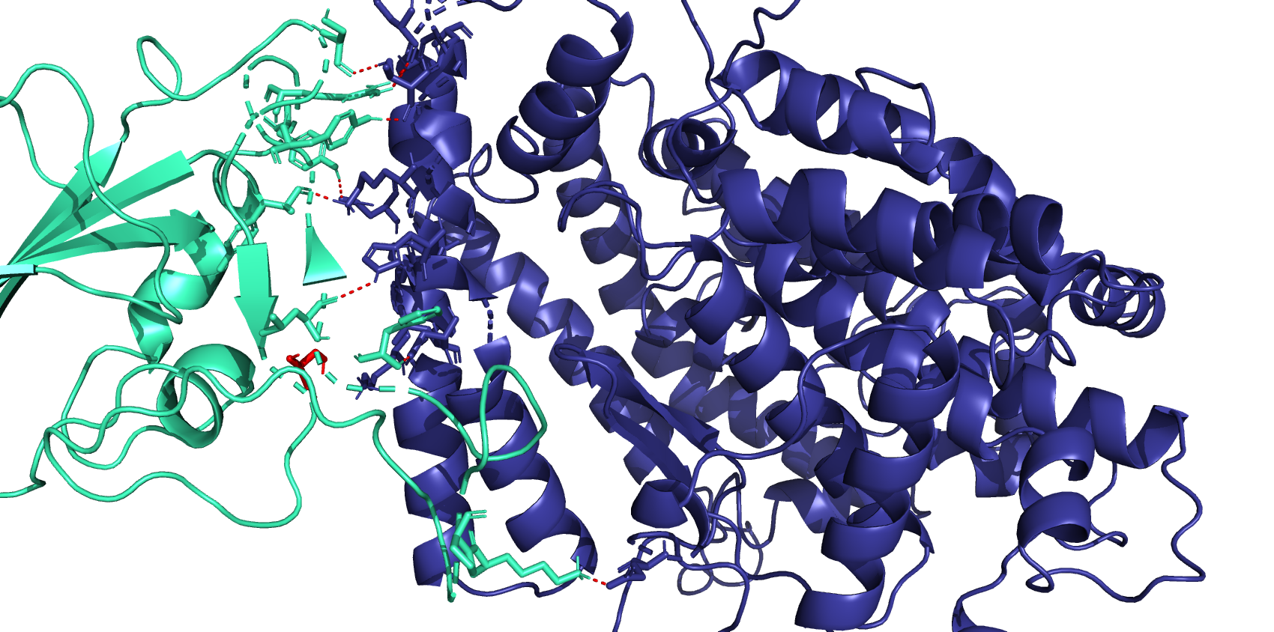
R497
S446
Y449
Y500
Y494
L491
F489
F72
S455
L39
K68
K478
(D)

Slide 10
T500
K478
G502
G496
R498
N486
Y495
C487
Y501
H504
S494
H34
F489
S490
E35
S493
H34
K31
Y494
H504
R497
T27
N487
T499
Y473
(A)
H445
(B)
R497
S446
Y449
R497
Y500
Y449
Y494
H504
S493
L491
Y494
F72
F489
F72
Q492
S455
L39
L491
K68
L39
L455
K478
K478
(C)
(D)
(C)

